Slide 1

Artificial Intelligence & Data Science
Implementation of Circular Queue
Mr. Prakash Kumar Pandey
Assistant Professor
Artificial Intelligence & Data Science

Slide 2
Artificial Intelligence & Data Science
Lesson Plan
Subject/Course | Competitive Coding
Lesson Title | Implementation of Circular Queue
Lesson Objectives
To explain the concept and purpose of a circular queue and how it differs from a linear queue.
To implement circular queue operations (enqueue, dequeue, front, rear, isFull, isEmpty) using an array-based approach in code.
Evaluate the time and space complexity of common circular queue operations.
To identify suitable scenarios in computer science or real-life where Circualr Queue is applicable and efficient.

Slide 3
Problem Statement:
Artificial Intelligence & Data Science
Write a program to design a circular queue(k) which Should implement the below functions
a. Enqueue
b. Dequeue
c. Front
d. Rear

Slide 4
Introduction to the Problem
Artificial Intelligence & Data Science
A Circular Queue is a linear data structure that follows the FIFO (First In First Out) principle.
Unlike a normal queue, the last position is connected back to the first position to make a circle.
This structure efficiently utilizes memory by reusing empty spaces created by dequeued elements.

Slide 5
Concept and Background
Artificial Intelligence & Data Science
Circular Queue connects the end of the queue back to the front.
It prevents wastage of space in a linear queue when elements are dequeued.
It can be implemented using Arrays, Linked List etc.
Two pointers are maintained:
  front → points to the first element.
  rear → points to the last element.
The queue is full when (rear + 1) % size == front.
The queue is empty when front == -1.

Slide 6
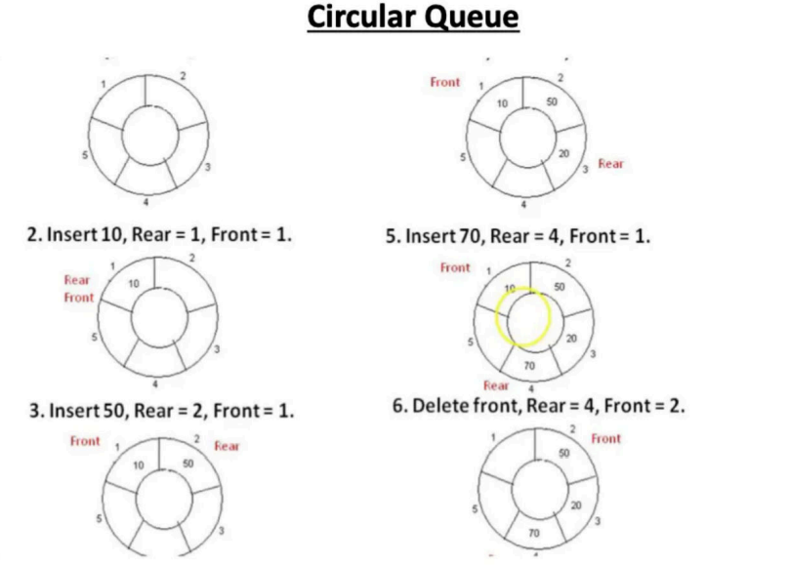
Visualization
Artificial Intelligence & Data Science
1.
4.Insert 20,Rear=3, Front =1

Slide 7
Queue Operations
Artificial Intelligence & Data Science
1. Enqueue (Insert): Add an element at the rear.
- Check if the queue is full.
- Update rear = (rear + 1) % size.
- Insert element at rear.
2. Dequeue (Delete):Remove an element from the front.
- Check if the queue is empty.
- Update front = (front + 1) % size.
3. Peek: Retrieve the front element without removing it.
4. Display: Print elements from front to rear circularly.

Slide 8
Conditions for Queue State
Artificial Intelligence & Data Science
• Queue Full Condition:
(rear + 1) % size == front
• Queue Empty Condition:
front == -1
• Reset Condition after last Dequeue:
If front == rear, then set front = rear = -1

Slide 9
Algorithm/Logic
Artificial Intelligence & Data Science
ENQUEUE(x):
1. If (rear + 1) % size == front → Overflow
2. Else if front == -1 → front = rear = 0
3. Else → rear = (rear + 1) % size
4. queue[rear] = x
DEQUEUE():
1. If front == -1 → Underflow
2. x = queue[front]
3. If front == rear → front = rear = -1
4. Else → front = (front + 1) % size

Slide 10
Algorithm/Logic
Artificial Intelligence & Data Science
Front(x):
1. If front != -1, then queue[front] is the front item.
Rear():
1. If rear != -1, then queue[rear] is the rear item.

Slide 11
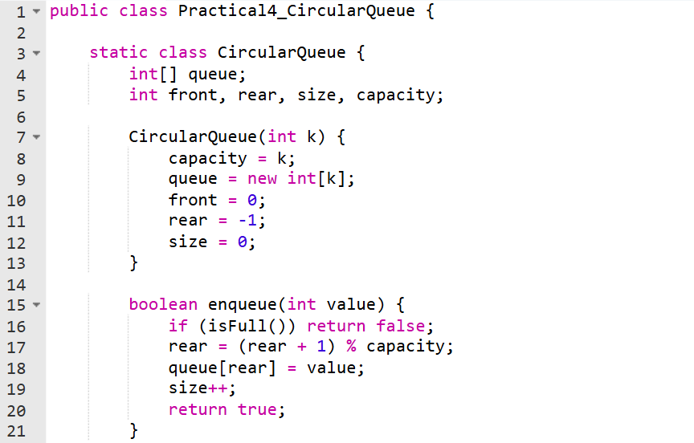
Code Implementation
Artificial Intelligence & Data Science

Slide 12
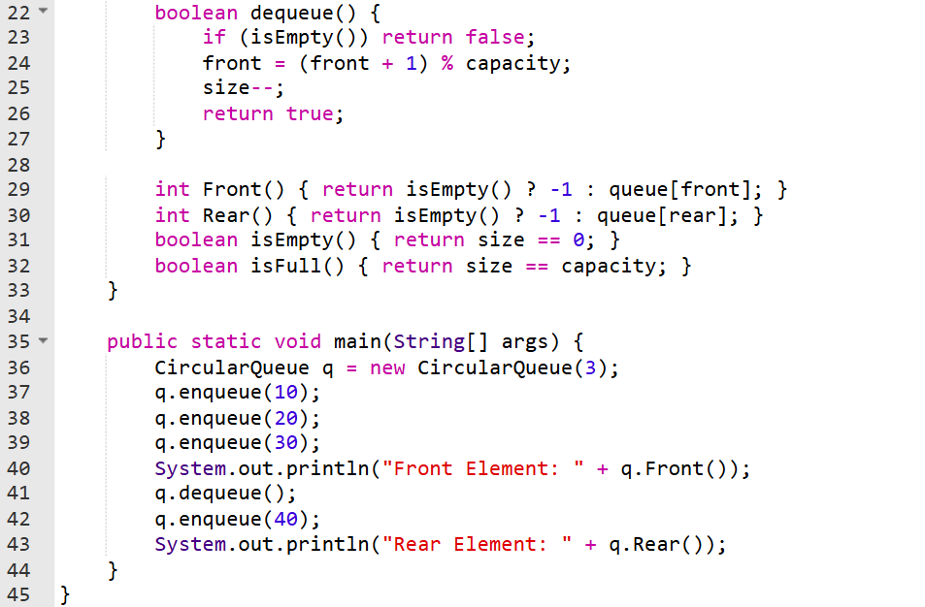
Artificial Intelligence & Data Science

Slide 13
Output :
Artificial Intelligence & Data Science
Front Element: 10
Rear Element: 40

Slide 14
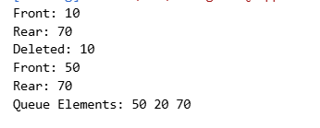
Output
Artificial Intelligence & Data Science

Slide 15
Time & Space Complexity
Artificial Intelligence & Data Science
• Enqueue Operation: O(1)
• Dequeue Operation: O(1)
• Peek Operation: O(1)
• Display Operation: O(n)
• Space Complexity: O(n)
Circular Queue provides efficient memory use and constant-time operations.

Slide 16
Summary
Artificial Intelligence & Data Science
Implemented a Circular Queue of capacity k supporting operations: enqueue, dequeue, front, and rear.
Used modular arithmetic to connect the last index back to the first, avoiding wasted space.
Handled overflow (queue full) and underflow (queue empty) conditions effectively.
Demonstrated the difference between linear queue and circular queue, emphasizing better memory utilization.
Strengthened understanding of queue data structure, front/rear pointers, and FIFO principle in data handling.

Slide 17
Practice Questions:
Artificial Intelligence & Data Science
1.Design Circular Deque -- LeetCode#641
https://leetcode.com/problems/design-circular-deque/
2.Find the Winner of the Circular Game -- LeetCode#1823
https://leetcode.com/problems/find-the-winner-of-the-circular-game/

Slide 18
Thanks
Artificial Intelligence & Data Science

